Slide 1
MS Teams Gateway Instance
Version 0.3 Oct 24

Slide 2
Background
We have been asked to support Microsoft teams with Aqua. It basically means that we can bring in standard (H.323/SIP) rooms into teams meetings. Microsoft will provide us a windows based SDK(Bot Framework), which we have to leverage to bring in standard signaling (SIP/H.323) and media (basically reapply RTP headers).

Slide 3
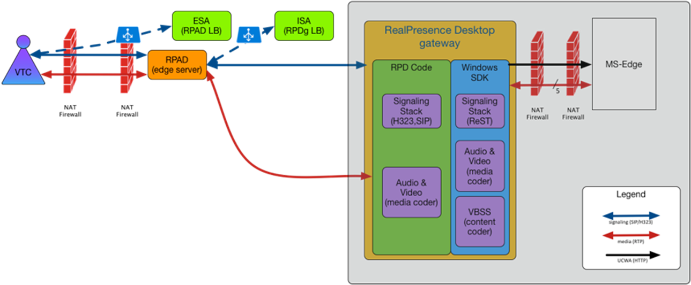
Solution Deployment Arch (From Jeff, initial version)
Under Discussion

Slide 4
Gateway Instance – Interface with other network elements
Instance Manager
Load Balancer
Coordinates/Configuration Service
Skype Calling Cloud
4) HTTP
Coordinates
Configuration
1) Initialization
/Common Configuration
MS EDGE
2) Registration
HTTP
3) SIP/H323 Signaling
Conf ID
Azure VM
5) MS HTTP SIGNALLING
RPAD
6) VTC RTP(AVC)
Gateway Instance Azure Service
6) MS RTP(SVC)

Slide 5
Gateway Instance High Level Soft Arch
Azure Service Interface
Gateway Instance Controller
Lookup/Rest
Call Coordinator
Coordinates Look up
VTC Call Module
Media Channel Binding Module
Teams Call Module
VTC Call Agent
Binding Management
Teams Call Agent
SIP/H323 Signaling
MS Signaling(Rest)
Under Discussion
RPD Call Control
(SIP/H323)
Media Processing
Channel Binder
Layout
MS Teams SDK
RTP/RTCP
MS RTP/RTCP
Decoded
Media
Decoded
Media
Format Transition

Slide 6
Current RPD Call Control Module
Call Control
Call Management
XML API
User
Interface
SIP Signaling Processor
H323 Signaling Processor
Capability Management
Socket
Capability Detection
Media Processing
VanSIP Stack
Radvision Stack
Capability Negotiation
Socket
BFCP Processor
SSL lib
XML lib
Log lib

Slide 7
Call Control Module
Module Interface (New)
Call Management
SIP Signaling Processor
H323 Signaling Processor
Capability Management
Capability Detection
VanSIP Stack
Radvision Stack
BFCP Processor
Capability Negotiation

Slide 8
Call Control Module
Need to replace XML API and add following API:
IUICallBack
IMPCallBack
CallControlInterface
Those API can be porting from CSS GW

Slide 9
Media Processing Module
Module Interface
Pipeline Management
Audio TX/RX pipeline
Video TX/RX pipeline
…
Content TX/RX pipeline
…
FECC TX/RX pipeline
…
Source capture
Source Render
data encoder
data decoder
Rtp send
Rtp receive
SSL lib
A/V codec lib
AEC lib
PPCIP lib
Face Brightness lib
Video Fence lib
Noise Blocker lib

Slide 10
Debut Media Processing Module
Has Replaced XML API and adding following API:
PipelineFactory
IPipeline
IPipelineCallbacks
IRTCPSession
VideoDataSourceManager
AudioDataSourceManager

Slide 11
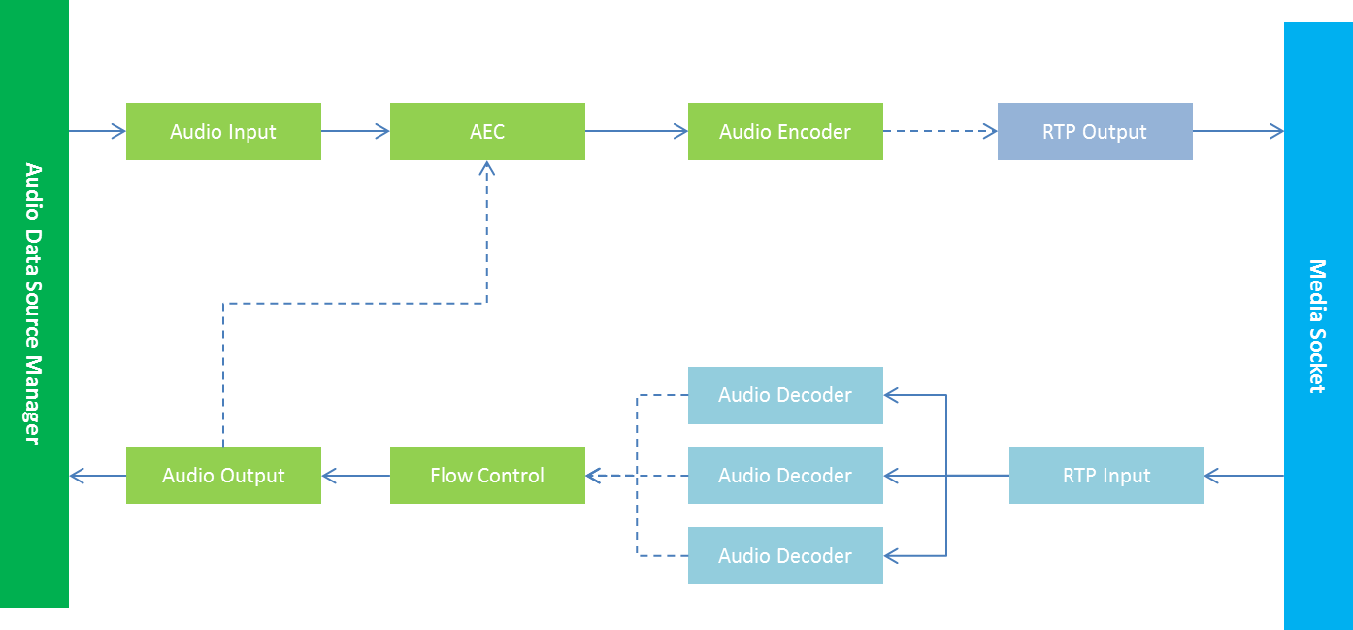
Audio Data Source Manager

Slide 12
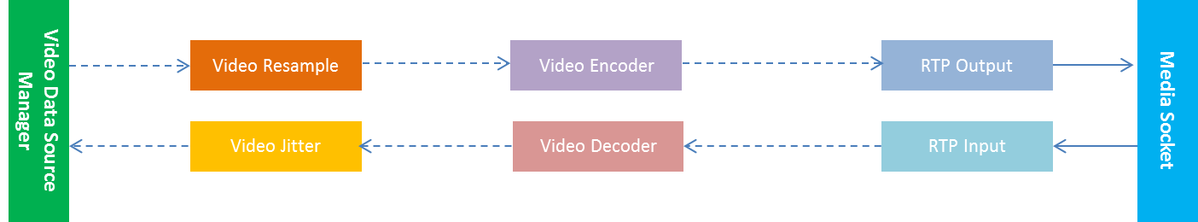
Video Data Source Manager

Slide 13
Gateway Instance Code Reuse
Call Control module
Reuse RPD call control
Support windows compiling
Support H323 and SIP
Media Processing module
Reuse Debut media control module
Reason to use Debut media control module
Optimized ARCH than RPD media processing
Support data source interface of each pipeline
Support windows compiling already

Slide 14
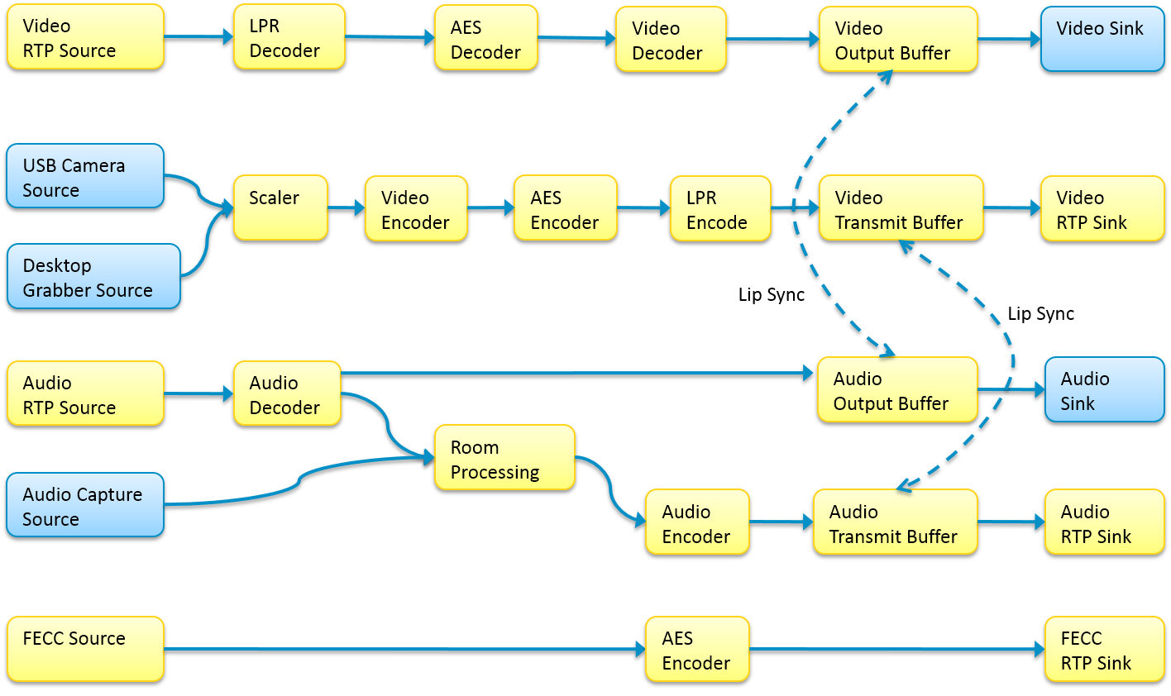
RPD Media Processing Module Pipeline

